Slide 1
Employee Management System

Slide 2
Technologies
Java 8
Spring Boot
Spring Security
Angular | React
PostgreSQL | MYSQL
Maven | Gradle

Slide 3
Problem Statement
To Create an application which provides below functionalities:
Create and maintain employee information.
Create and maintain department information.
Provision for mapping employees to their departments
Creation of Regulation/Legislation (RL) document.
Tracking the compliance of department through status.
Tracking user comments on regulation.

Slide 4
Plan
Design
Generate the skeleton as per class design provided
TDD approach
Identify test cases for each module
Write Failing Test cases
Convert the Test Cases in GREEN
Implement the case study in incremental manner

Slide 5
Modules
Login Module
Employee Module
Department
Module
regulation / legislation
Module

Slide 6
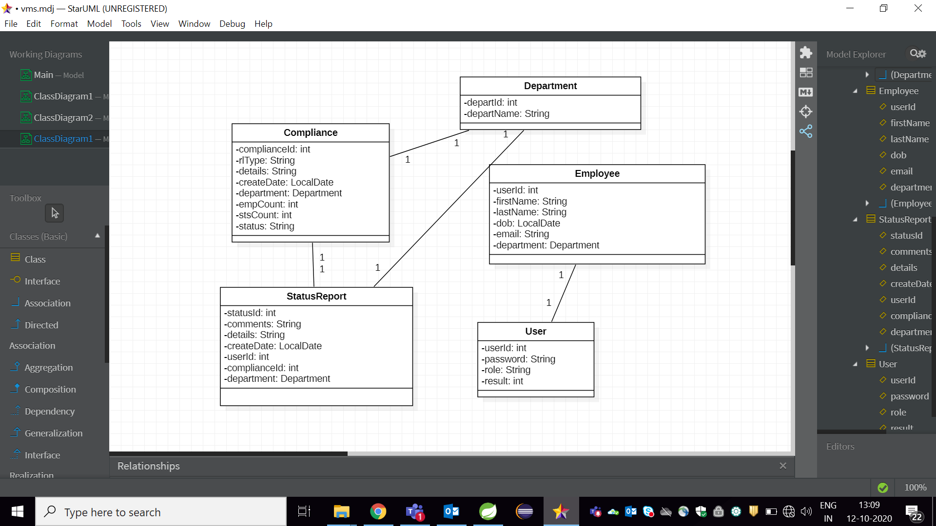
Class Design [POJO Classes]

Slide 7
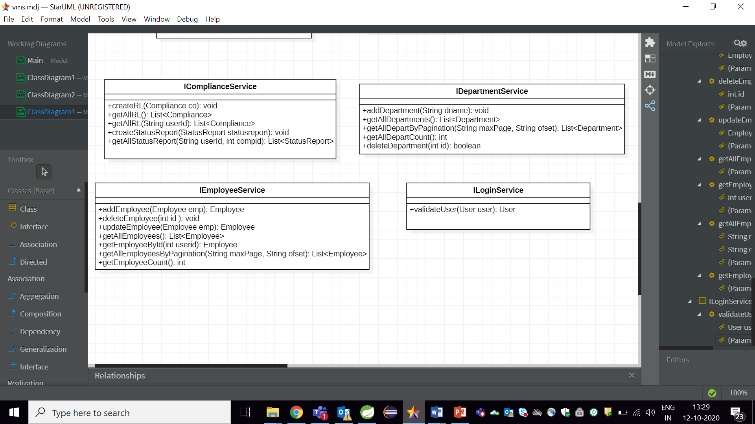
Class Design [Service Interface]

Slide 8

Class Design [Repository]

